Slide 1

Методический сборник "Keep yourself boosted"для самостоятельной работы учеников 10-х классов по учебнику УМК "Spotlight",направленный на развитие функциональной грамотности учащихся
Над сборником работали студентки ВятГУ:​
Юферева София​
Широкова Мария​
Никулина Виктория​
Беорыбкина София
Куратор:
Поздеева Екатерна Владимировна, преподаватель английского языка в «Средней общеобразовательной школа № 56» города Кирова
2025-2026

Slide 2

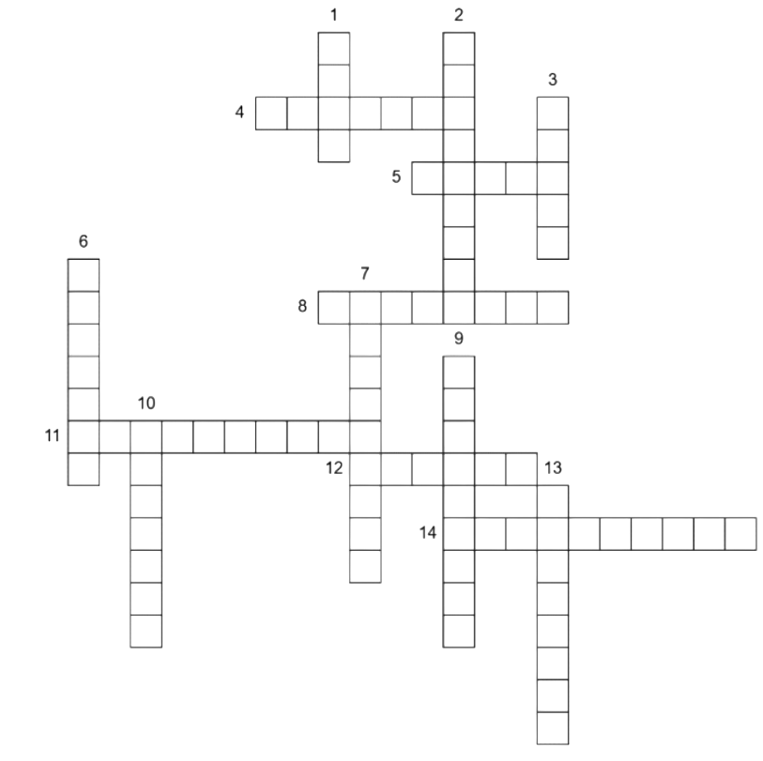
Module 1. Strong ties
Write synonym/synonyms for the highlighted word in the text
"I really like shopping. I think it's a relaxing, enjoyable pastime. So much so, I can spend hours window shopping in the city centre with my friends. H&M is my favourite clothes shop because you can always find great bargains there. I also like going to the cinema and I try to catch a film at least once a fortnight with my friend, Tom. Everyone my age is crazy about mobile phones and texting has become a new national pastime!"
"During the week I don't do much in the evenings apart from my homework, so | really look forward to the weekends.
On Saturdays, I usually hang out with my friends down at the shopping mall where we check out the shops for new clothes, grab a bite to eat and watch a movie.
On Sundays, 1 usually go for a trip to the countryside with my parents. I love that."
"I like keeping fit, buying expensive clothes and dance music!
I love going out clubbing with my friends at the weekends - we dance all night. I have two younger sisters, but we fight a lot because they always want to wear my clothes. That's so annoying - I hate it when they do that!"
Do the crossword
Down: unkind to another person not truthful, cannot be trusted firm in their support for a person 6. caring only about themselves 7. admired and considered important 9. calm, not easily annoyed 10. kind and helpful during difficult or unhappy times 13. able to invent and develop original ideas | Across: 4. angry or bitter about smth 5. angry or depressed without any warning 8. devoted and enthusiastic 11. kind and helpful during difficult or unhappy times 12. affectionate, helpful and sympathetic 14. angry and violent

Slide 3
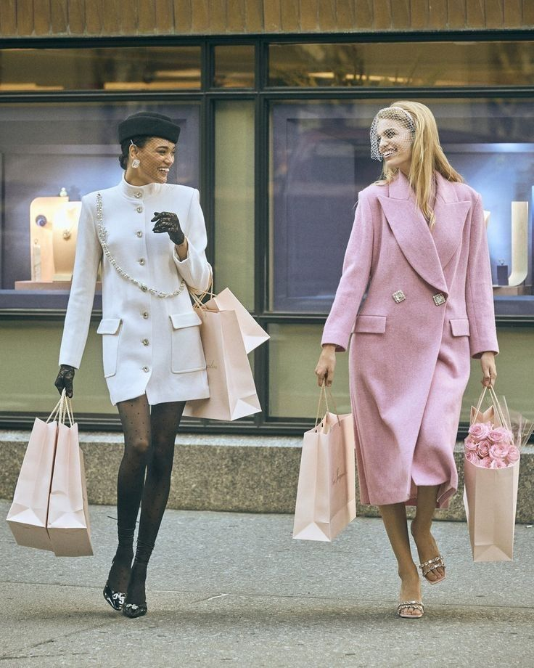
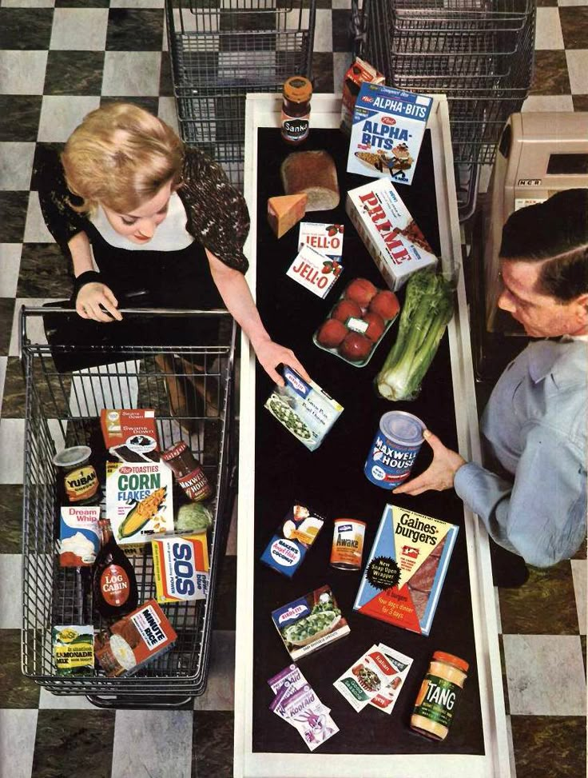
3. Fill in the gaps
Weekend Vibes and Future Dreams
Maya often (1) (feel) exhausted by Friday afternoon. She (2) (attend) school all week and then (3) (practice) basketball every evening. Last Saturday, however, things (4) (be) different. She and her friends (5) (decide) to explore the new art gallery downtown. They (6) (not visit) it before, so they (7) (be) really excited to go. While they (8) (look) at the modern sculptures, Maya (9) (take) lots of photos with her phone. They (10) (have) a truly great time together.
Currently, Maya (11) (work) on a school project about local history. She (12) (interview) a historian next Tuesday for it. She (13) (hope) to finish the main research by the end of this weekend. Looking further ahead, next summer, Maya (14) (plan) to volunteer at a summer camp for kids. She (15) (think) that helping others is a wonderful way to spend her free time, and these experiences will be invaluable.
Choose 1 picture to ask 4 questions about it, and describe the second picture in full using the following plan:
1.people 2. place 3. present continuous action 4. appearance | 5. clothes 6. feelings, emotions of people/ why do they feel it? 7.do you like/ dislike the picture and why

Slide 4
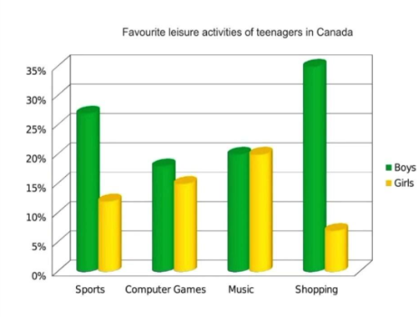
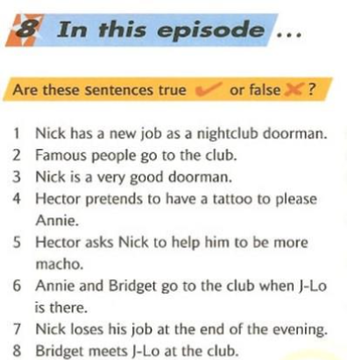
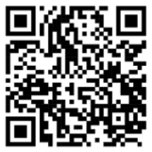
6. Watch the episode and be ready to do this exercise in the next class
QR на сериал:
5. Write 7 sentences about this statistic and give your opinion.

Slide 5
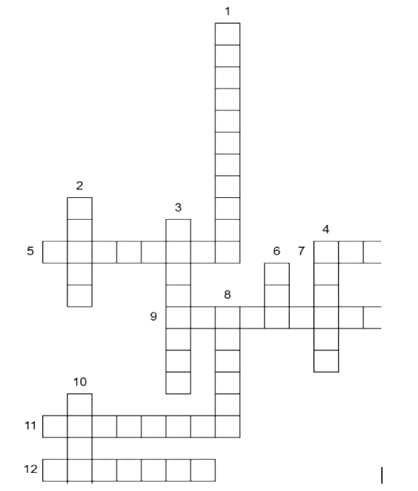
Module 2. Living & spending
Write synonym/synonyms for the highlighted word in the text
Sweets and chocolates are still the number one best seller, but sales of mobile phone cards are (1) catching up quickly, and they are expected to overtake sweets and chocolates very soon.
Modern technology is (2) rapidly replacing traditional favourite pastimes such as board games and reading with video game consoles like PlayStation 2 and Xbox, which cost over £300. Quite a lot of teenagers have also joined clubs that involve extreme sports, such as gliding and parachuting. This means that parents are (3)digging deeper into their pockets than ever before. They are (4)handing out a massive €3.3 billion to their teenagers every year, but is this enough? Obviously not, because this is only 60% of what they are spending!
Teenagers are (5)making ends meet by doing (6)odd jobs, such as helping with the chores around the house, delivering newspapers, and working weekends as sales assistants in shops. Although they earn and receive the same amount of money, girls spend more than boys.
2. Do the crossword
Across: 5. careful to avoid potential problems or dangers; wary 7. nervous or timid in the company of other people 9. having or showing a strong desire and determination to succeed 11. friendly and socially confident; extroverted 12. free from tension and anxiety | Down: 1. willing to take risks or to try out new methods, ideas, or experiences 2. ready to face and endure danger or pain; showing courage 3. willing to engage in social activities; friendly 4. having the power to move heavy weights or perform other physically demanding tasks 6. in good physical condition; healthy and strong 8. having or showing a strong desire and determination to succeed 10. making little or no noise; peaceful, calm

Slide 6
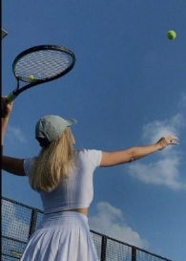
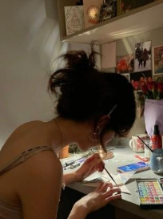
3. Fill in the gaps:
The Spending Dilemma
Ever since she (1) (start) her part-time job last month, Chloe(2) (save) diligently. She (3) (plan) to buy a new, high-tech camera, which she (4) (want) for ages to improve her photography skills. Today, she finally (5) (receive) her latest paycheck, and she (6) (have) enough money for it.
However, as she (7) (walk) home, she (8) (see) a flyer for a local animal shelter. It stated that they (9) (struggle) to pay for emergency medical treatments for new rescues. Chloe (10) (think) about her own cat, Luna, whom she (11) (rescue) from a similar shelter two years ago.
She (12) (know) that the camera (13) (be) an exciting purchase, but the animals (14) (need) help right now. She (15) (make) her final decision later this evening after carefully considering both options. It wasn't just about spending money; it was about making a choice that felt right.
Choose 1 picture to ask 4 questions about it, and describe the second picture in full using the following plan:
1.people 2. place 3. present continuous action 4. appearance | 5. clothes 6. feelings, emotions of people/ why do they feel it? 7.do you like/ dislike the picture and why

Slide 7
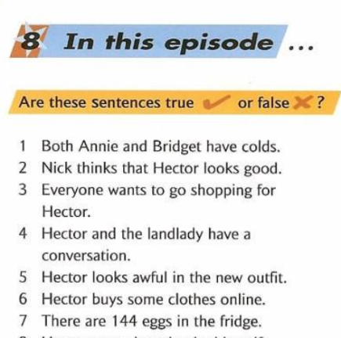
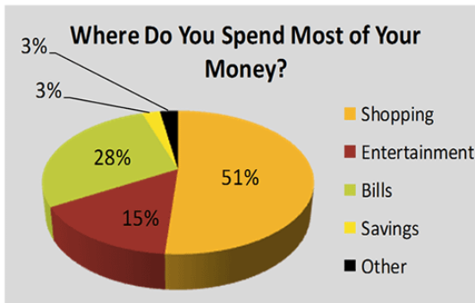
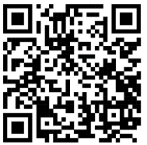
6. Watch the episode and be ready to do this exercise in the next class:
QR на сериал:
5.Write 7 sentences about this statistic and give your opinion.

Slide 8
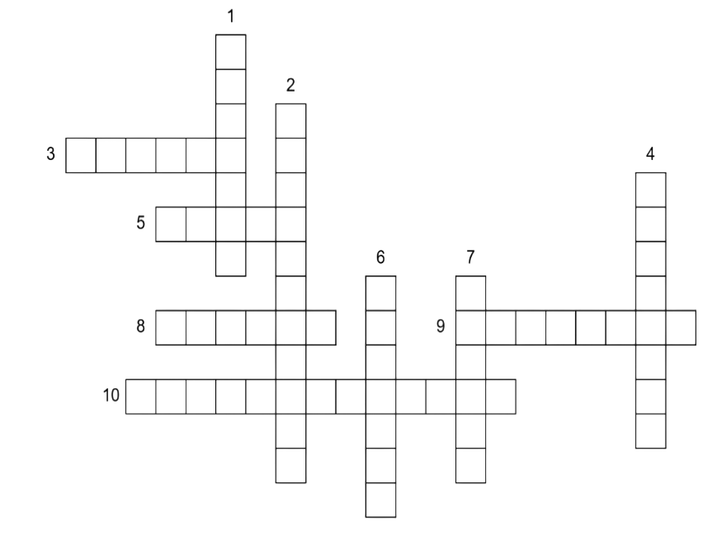
Module 3 . Schooldays and work
1. Write Russian equivalents for these words
Artist-
Author-
Translator-
Plumber-
Gardener-
Carpenter-
Mechanic-
Fisherman-
Businessman-
Managing director-
Bank clerk-
Secretary-
Architect-
Lawyer-
Engineer-
2. Complete the crossword:
Vertical 1. Sunny weather is ________ for Saint Petersburg 2. My teacher asked me to _________ in the conference. 4. The light bulb was ______ in 1879. 6. Sometimes, when a child behaves badly, parents can be _______ . 7. At university, you must _______ classes. | Horizontal 3. You won't do something well if you don't have the ______ . 5. A good gentleman must be ________ . 8. Sometimes I prefer to take a taxi rather than ________ transport 9. Your ________ in the gym should be intense if you want to have a great body. 10. Parents of schoolchildren voted for the __________ uniform.

Slide 9
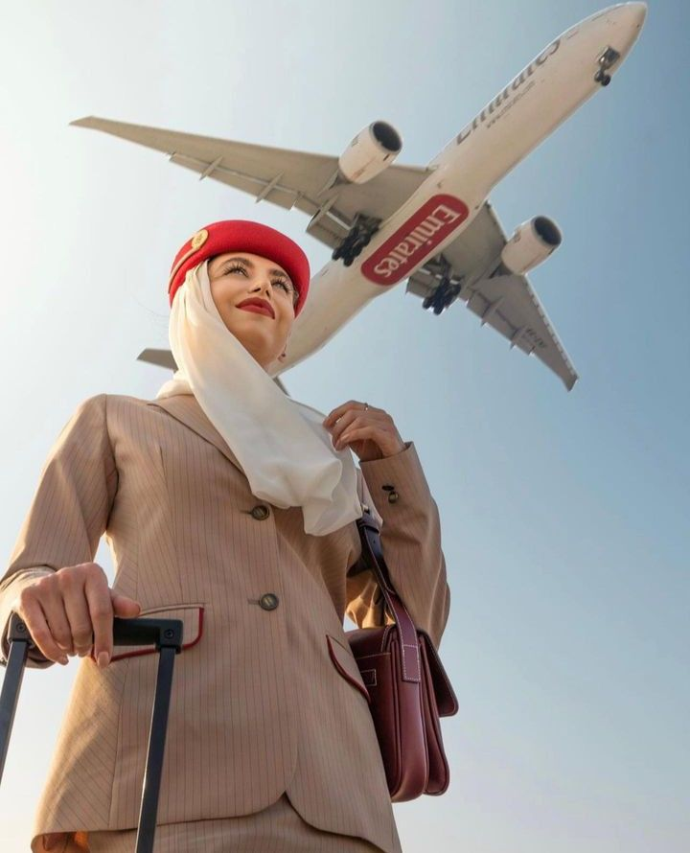
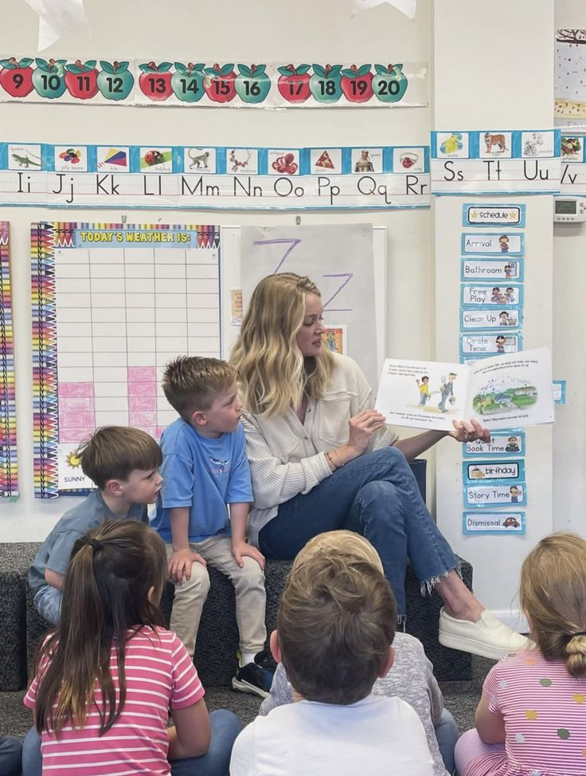
3. Fill the gaps with verbs in Future Tenses
School Days and Future Jobs
Life during school can feel like a long stretch of exams and homework, but it's really the foundation for what (1) __ (you / become). Think about your favorite subjects now. If you enjoy science, you might decide that next year you (2) __ (study) advanced biology, preparing for a medical career.
By the time you graduate high school, your choices (3) __ (determine) the path you take into higher education. The job market is constantly changing, so the skills you learn today are vital. If you plan to be a software developer, you can be sure that by 2035, technology (4) __ (advance) significantly. You must keep learning. For example, if you start learning a new programming language this month, by the end of the year, you (5) __ (master) it for several months, making you a much stronger candidate for a junior position.
Remember that whatever career you choose, you (6) __ (always / need) the critical thinking and teamwork abilities you gained in school. What exciting project do you think you (7) __ (work) on this time next year? Make the most of your school days; the future (8) __ (not / wait)!
Choose 1 picture to ask 4 questions about it, and describe the second picture in full using the following plan:
1.people 2. place 3. present continuous action 4. appearance | 5. clothes 6. feelings, emotions of people/ why do they feel it? 7.do you like/ dislike the picture and why

Slide 10
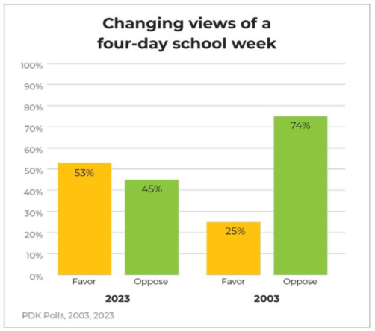
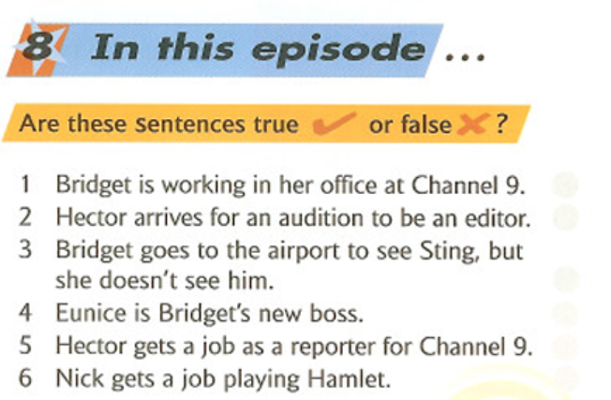
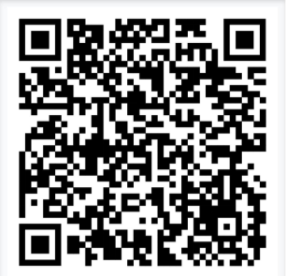
5. Write 7 sentences about this statistic and give personal opinion.
6. Watch the episode and be ready to answer the questions in the next class:
QR на сериал:

Slide 11
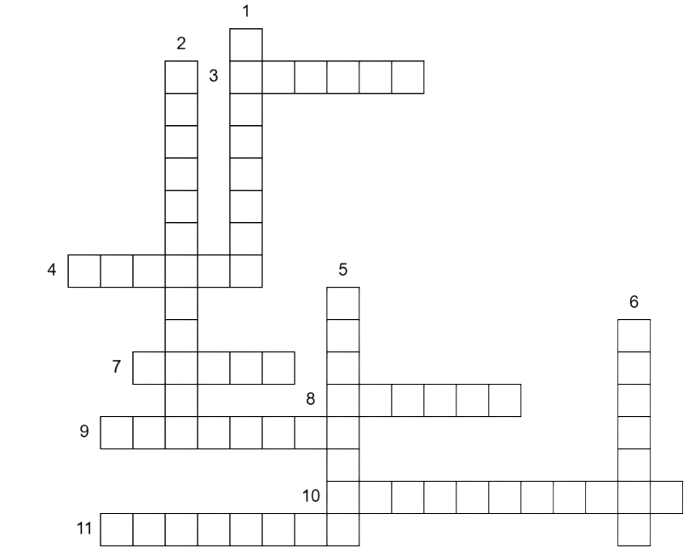
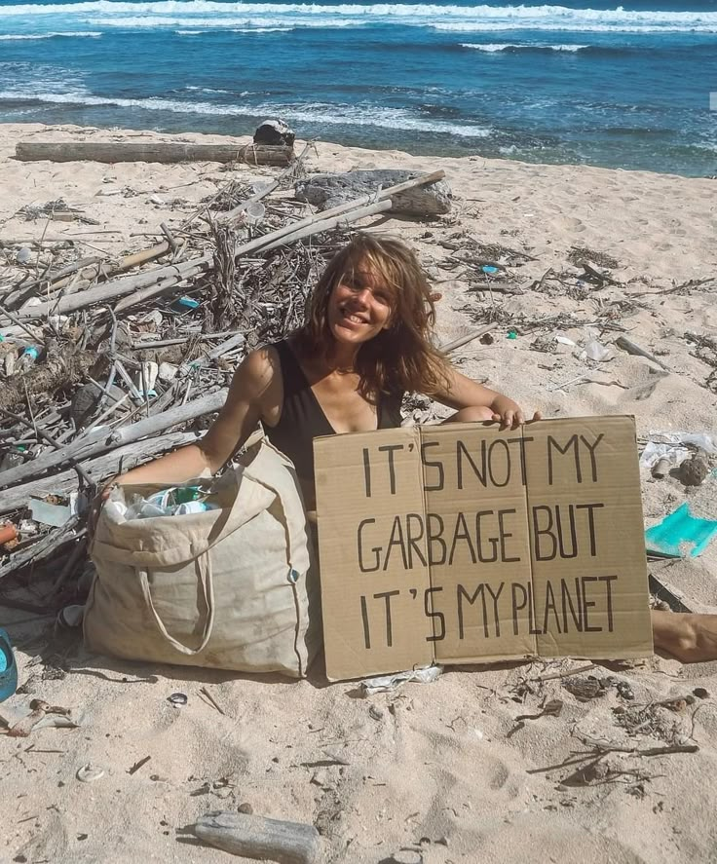
Module 4. Earth alert!
1. Write Russian equivalents for these words
Process-
Absorbs-
sucks up-
Roots-
Subtance-
Reaction-
Converts-
Equation-
2. Complete the crossword:
Horizontal: 3. We need to wear several __ of clothing to stay warm in the snow. 4. The actor is __ in a new play this weekend. 7. It's very __ and hot outside today, like before a storm 8.The dense forest __ blocks most of the sunlight from reaching the ground. 9. You can often see moss growing on the rough surface of the __. 10.Below the __, you find smaller plants and young trees. | Vertical: 1. The security guard was __ people to enter the building. 2. She took a spoon of __ to soothe her sore throat. 5.Don't __ your tongue at people; it's rude. 6.The large pizza was __ into eight equal slices. 11.The tallest trees in the rainforest reach the __ layer, soaring above the others.

Slide 12
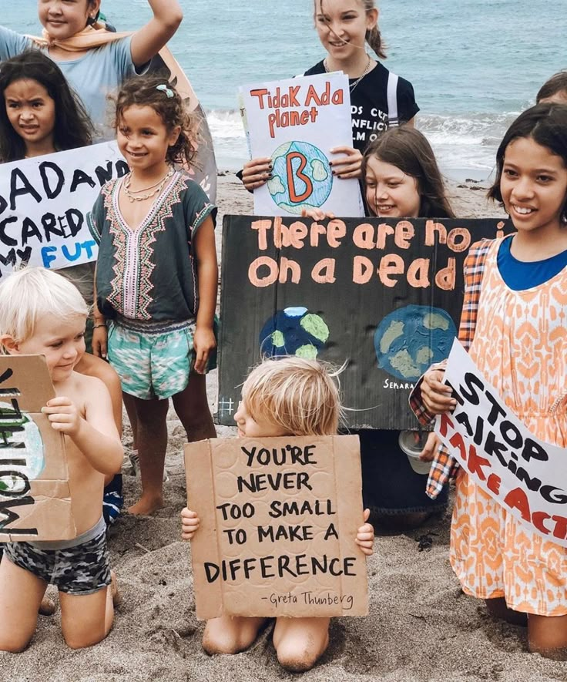
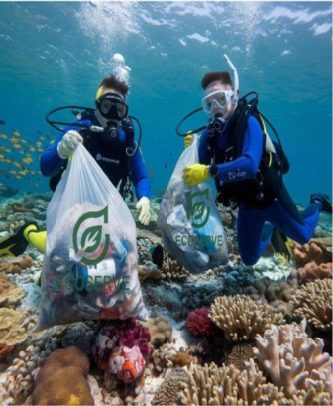
Choose 1 picture to ask 4 questions about it, and describe the second picture in full using the following plan:
3. Fill the gaps with modal verbs
Saving Our Home: A Collective Responsibility
The future of our planet is at a critical juncture. For decades, scientists have (1) warned us about the irreversible damage caused by climate change and pollution. Now, we (2) act decisively.
Every person (3) recognize that they (4) play a part. We (5) continue to rely heavily on fossil fuels; we (6) transition to renewable energy sources like solar and wind power immediately. Governments (7) enforce stricter environmental regulations, and corporations (8) prioritize sustainability over profit.
As individuals, we (9, not) waste water and electricity. We (10) rethink our consumption habits, embracing recycling and reducing our carbon footprint. If we all adopted a more sustainable lifestyle, the impact (11) be truly significant. Moreover, we (12) educate the next generation, ensuring they understand the stakes.
We (13, not) despair, as the potential for change is vast. However, we (14) take immediate action; this is not a problem for future generations alone. We (15, not) wait any longer to secure a healthy Earth.
1.people 2. place 3. present continuous action 4. appearance | 5. clothes 6. feelings, emotions of people/ why do they feel it? 7.do you like/ dislike the picture and why

Slide 13
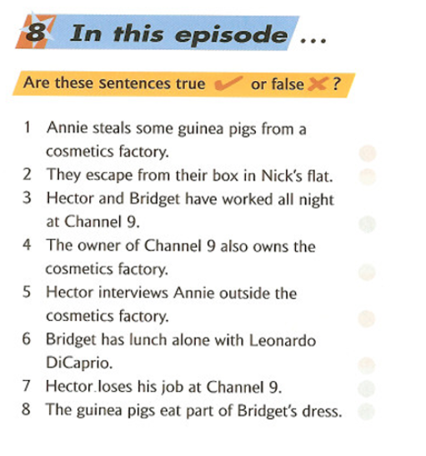
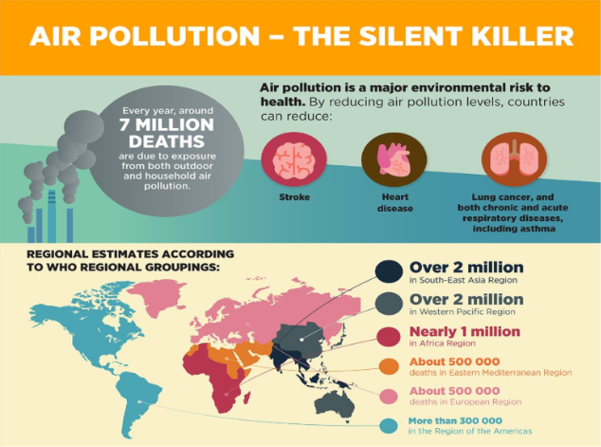
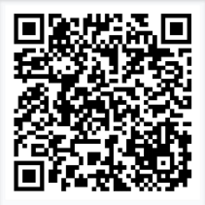
5. Write 7 sentences about this statistic.
6. Watch the episode and be ready to answer and discuss
QR на сериал:

Slide 14
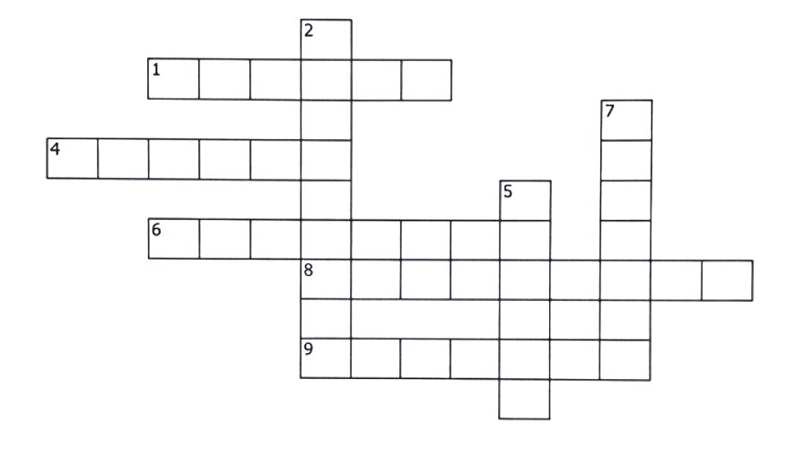
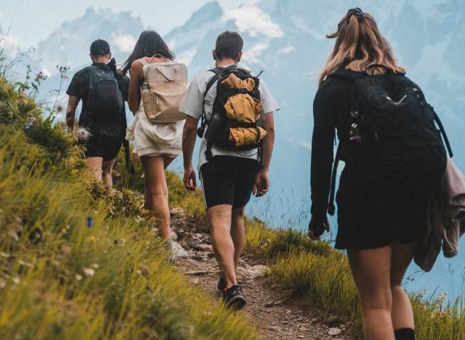
Module 5. Holidays
1. Write the definitions for the following words
Package holiday –
Sightseeing –
Resort –
Backpacking –
Cruise –
Travel insurance –
Souvenir –
2. Complete the crossword:
Across 1.A place where people go for holidays, usually with hotels and beaches. 4.A journey made by air, especially in a plane. 6.The bags and suitcases you take with you on a trip. 8. An official document you need to show when traveling to another country. 9.A device used for taking photos or recording videos. | Down 2.The place you are finally going to. 3. Visiting famous and interesting places as a tourist. 5. Someone who shows tourists around and tells them about a place. 7.A long trip from one place to another

Slide 15
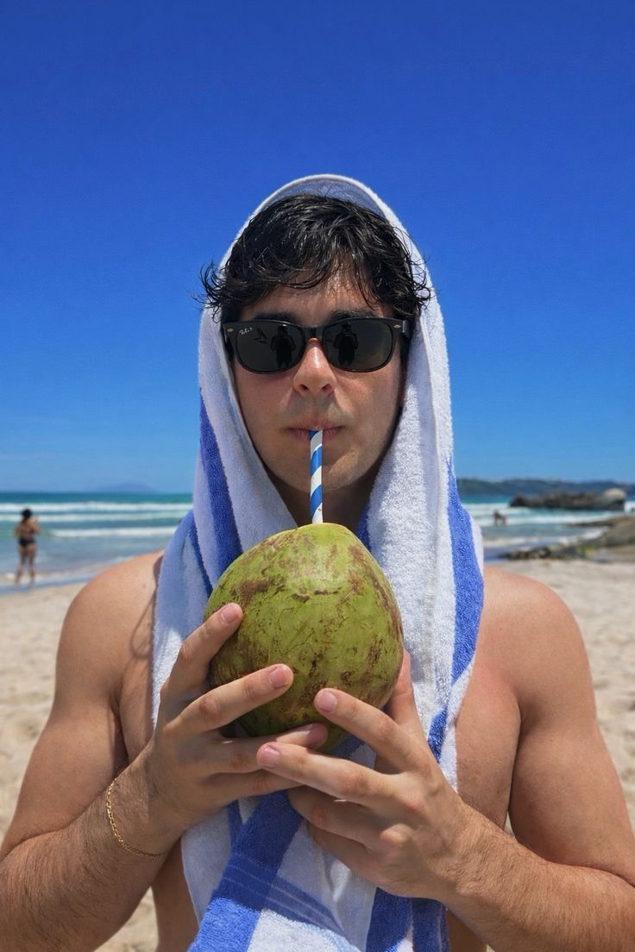
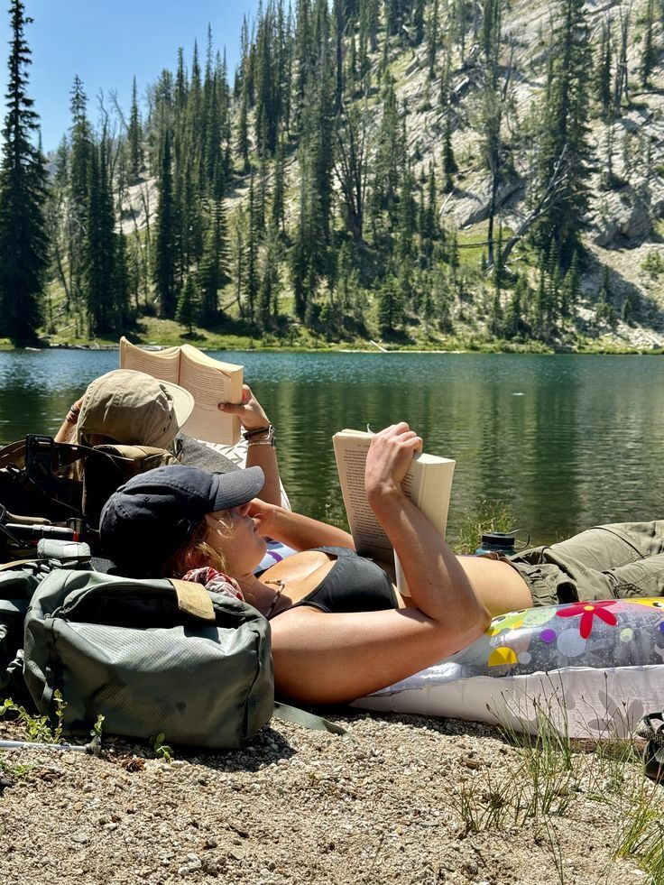
3. Fill in the gaps
Holidays ______ (1. be) very important for people because they help us relax and enjoy life. Last summer, my family and I ______ (2. decide) to go abroad. We ______ (3. travel) to Italy and ______ (4. stay) in a small hotel near the sea. The hotel ______ (5. be) comfortable and the staff ______ (6. be) very friendly. Every morning, we ______ (7. wake) up early and ______ (8. have) breakfast on the terrace. Then we usually ______ (9. go) sightseeing and ______ (10. visit) famous places. Sometimes we ______ (11. take) guided tours and ______ (12. learn) a lot about the history of the country. In the afternoon, we often ______ (13. swim) in the sea or ______ (14. relax) on the beach. The weather always ______ (15. be) warm and sunny. In the evenings, we ______ (16. go) to local cafés and ______ (17. try) traditional food.
I really ______ (18. enjoy) the pizza and pasta. I ______ (19. feel) happy during the trip because we_____ (20. spend) a lot of time together. Holidays ______ (21. help) people forget about everyday problems and ______ (22. give) them new energy. I ______ (23. believe) that travelling ______ (24. be) one of the best ways to learn about the world
Choose 1 picture to ask 4 questions about it, and describe the second picture in full using the following plan:
1.people 2. place 3. present continuous action 4. appearance | 5. clothes 6. feelings, emotions of people/ why do they feel it? 7.do you like/ dislike the picture and why

Slide 16
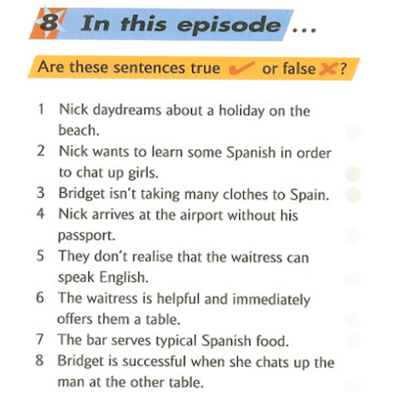
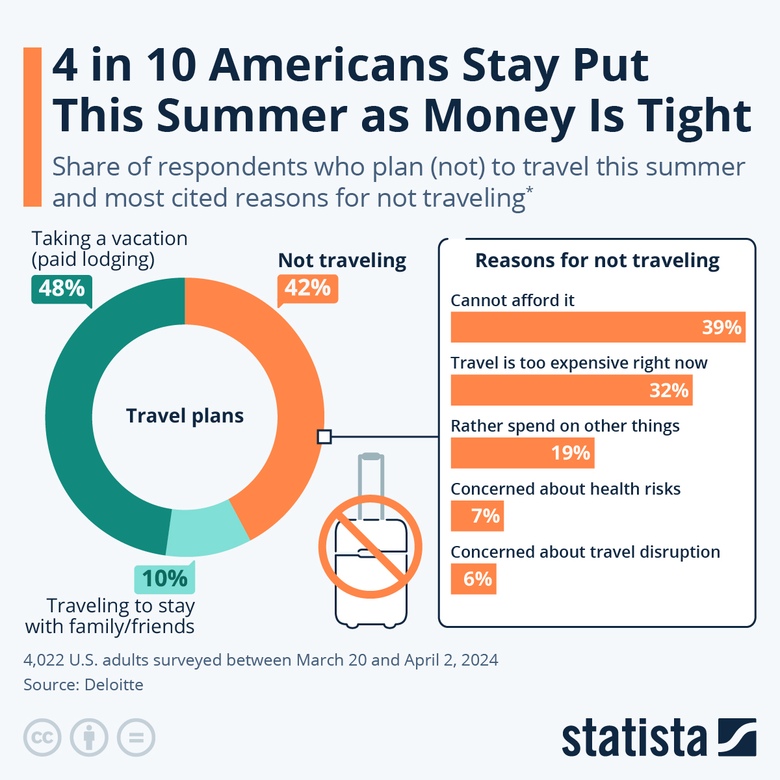
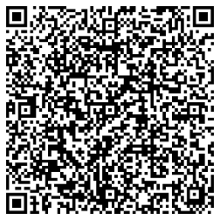
5. Write 7 sentences about this statistic and give your personal opinion.
6. Watch the episode and be ready to answer the questions in the next class: ​
QR на сериал:

Slide 17
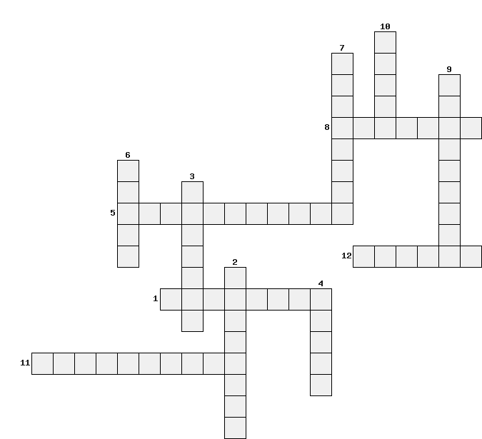
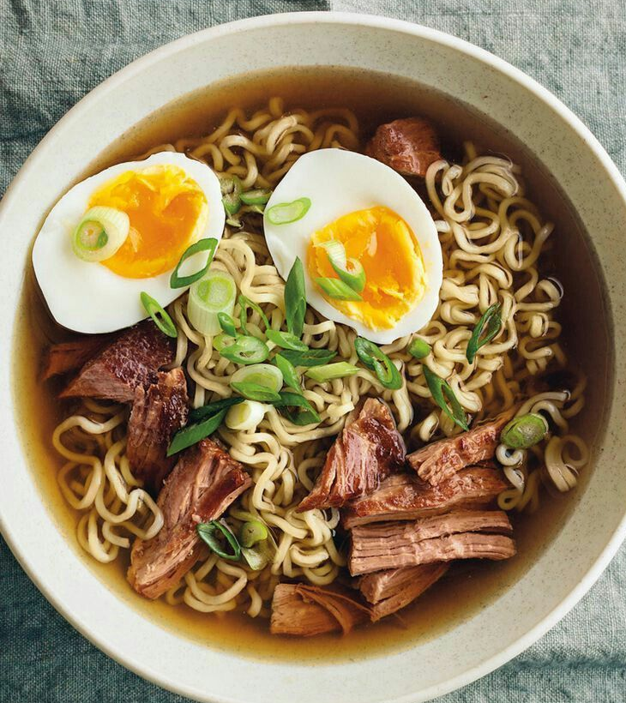
Module 6. Food & Health
1. Write the definitions for the following words
Balanced diet –
Junk food –
Obesity –
Calories –
Lifestyle –
Food poisoning –
Nutrients -
2. Complete the crossword:
Down 2)A diet that contains the right amounts of different types of food to stay healthy. 3)A substance found in meat, eggs, and beans that helps the body grow and repair itself. 6)Products that are made from milk, such as cheese, butter, and yogurt. 7)Units used to measure the amount of energy that food provides. 9)Substances found in food that plants and animals need to live and grow. 10) A part of plant food that helps your digestive system work correctly. | Across 1)Natural substances found in food that are necessary for your body to work properly. 4) A small amount of food eaten between main meals. 5) The different foods that you combine to make a particular dish. 8) A medical condition of being very fat in a way that is unhealthy. 11) A person who does not eat meat or fish for various reasons. 12) Food that contains a lot of oil or fat, often typical for fast food.

Slide 18
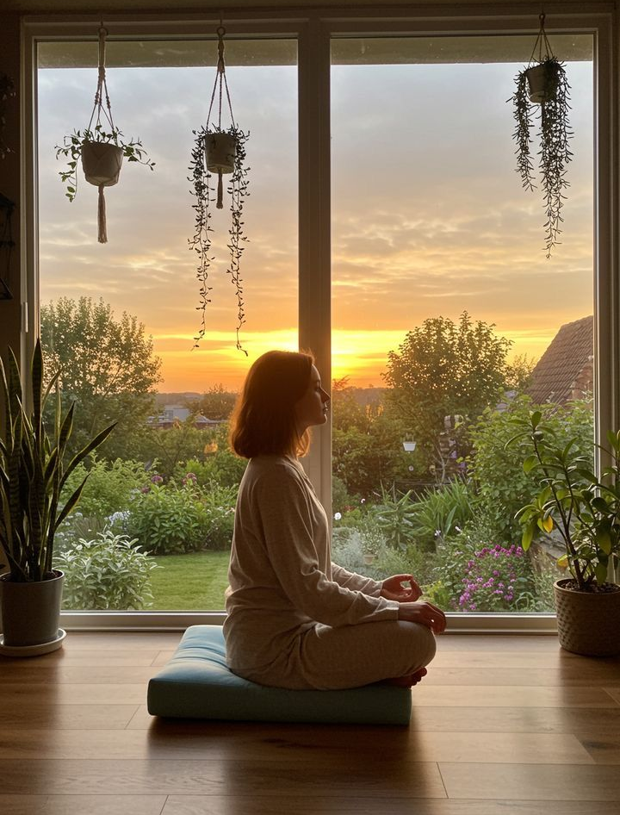
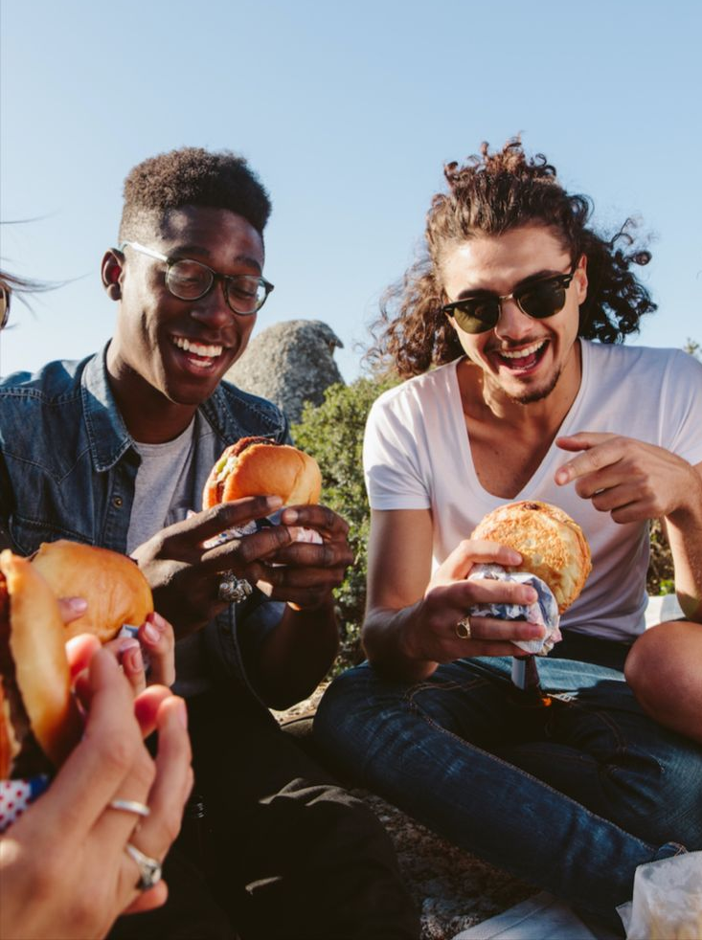
3. Fill in the gaps
Food and health ______ (1. play) an important role in our lives. People who ______ (2. have) a balanced diet usually ______ (3. feel) more energetic and healthy. Nowadays, many teenagers_____ (4. eat) too much junk food and ______ (5. not think) about their health.A healthy diet ______ (6. include) fruit, vegetables and proteins. It ______ (7. help) the body get all necessary nutrients. People who ______ (8. eat) too many calories often ______ (9. suffer) from obesity and other health problems.
Regular exercise ______ (10. be) also very important. It ______ (11. improve) physical health and ______ (12. reduce) stress. Doctors often ______ (13. advise) people to change their lifestyle if they ______ (14. want) to stay healthy.
Last year, I ______ (15. decide) to eat better. I ______ (16. stop) eating fast food and ______ (17. start) cooking healthy meals. This experience ______ (18. teach) me to take care of my body. I ______ (19. believe) that healthy habits ______ (20. be) the key to a long and happy life.
Choose 1 picture to ask 4 questions about it, and describe the second picture in full using the following plan:
1.people 2. place 3. present continuous action 4. appearance | 5. clothes 6. feelings, emotions of people/ why do they feel it? 7.do you like/ dislike the picture and why

Slide 19
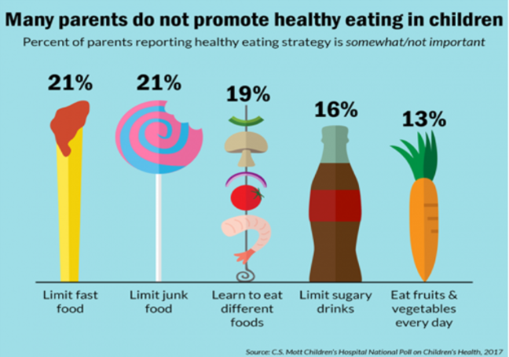
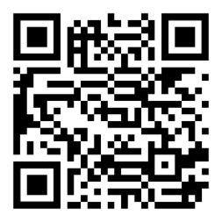
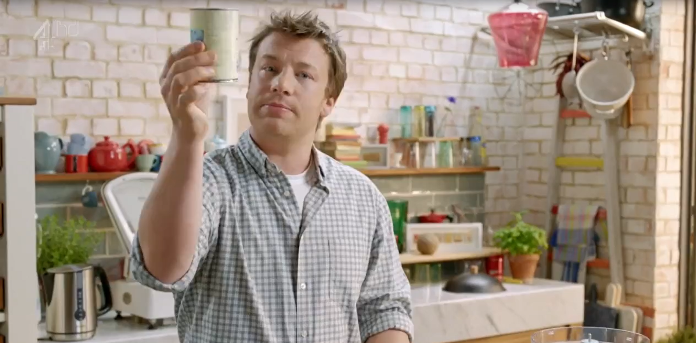
5 Write 7 sentences about this statistic and give your personal opinion.
6. Watch this video till 7.25 and make a list of ingredient that man used

Slide 20
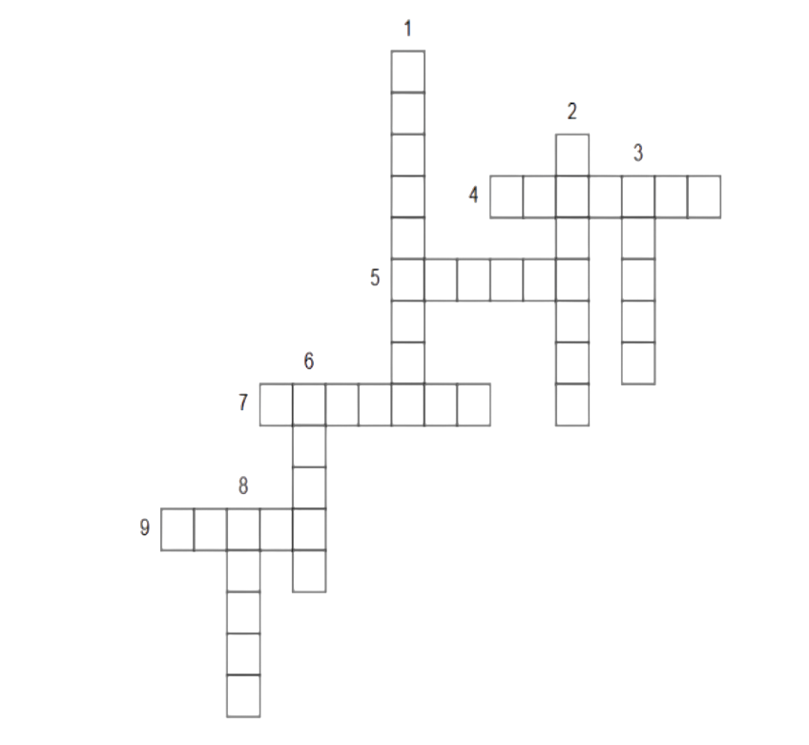
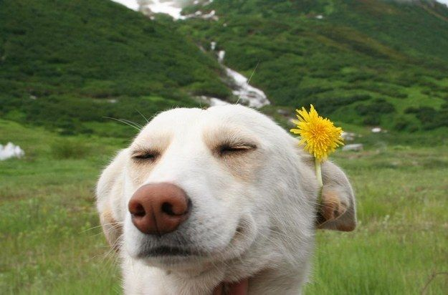
Module 7. Let`s have fun
1. Write the definitions for the following words.
Blaring –
Consuming –
Fetched –
Review –
Distribute –
Artificially –
Empowering –
2. Complete the crossword:
Down 1.a group of instrumentalists, especially one combining string, woodwind, brass, and percussion sections and playing classical music 2.small, low-powered binoculars 3.a mucical play in which all or most of words are sung 6. a person who shows people to their seats, especially in a cinema or theatre or at a wedding 8. a passage between rows of seats in a building such as a church or theatre, an aircraft, or train | Across 4. the highest tier of seats in a theatre, above the dress or upper circle 5. the seats on the ground floor in a theatre 7. a piece of material suspended at the top to form a screen, typically movable sideways along a rail and found as one of a pair at a window 9. the platform on which the actors perform in a theater.

Slide 21
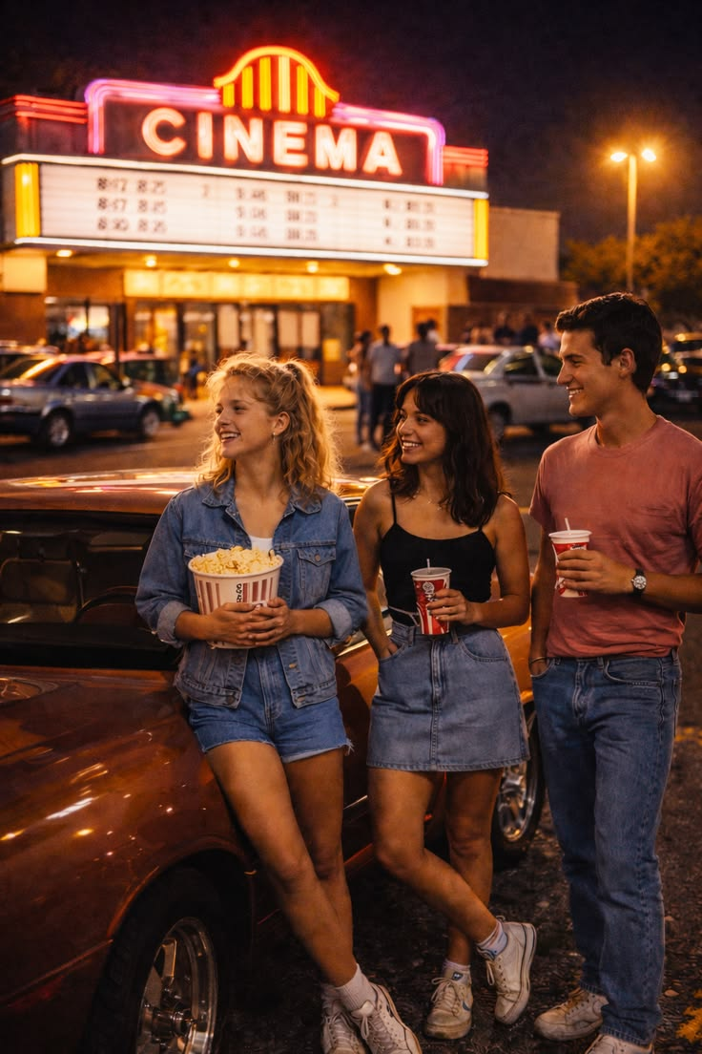
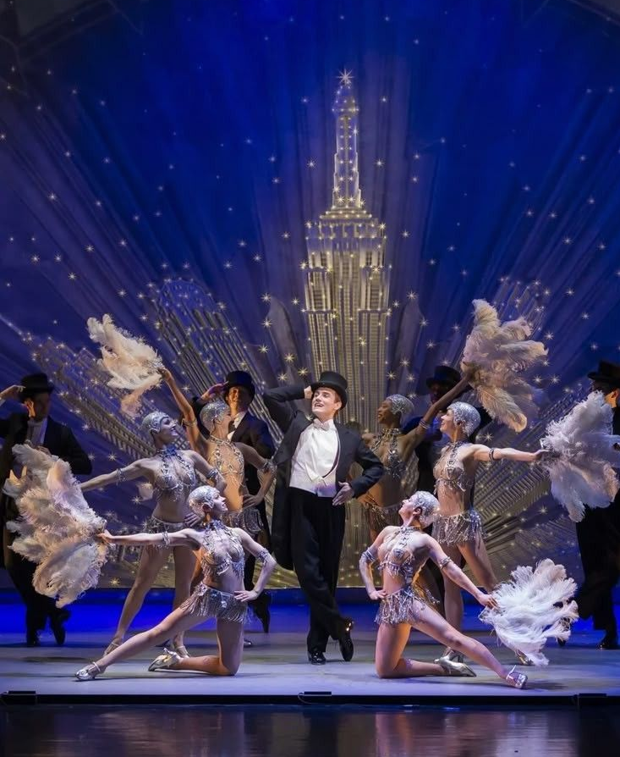
3. Fill in the gaps.
1. My brother is a very __________ actor; everyone knows his name.
2. She got __________ with all the complaints and decided to leave the meeting.
3. He's so __________ – he acts nice to your face but talks about you behind your back.
4. We need to find a more __________ solution to this problem, not just a temporary fix.
5. Many young people dream of becoming a __________ model.
6. Could you please __________ the radio __________? I want to listen to the news.
7. It's too quiet here. Let's __________ the music __________ a bit!
8. I had to __________ the invitation __________ because I was already busy that evening.
Words to insert:
turn ... up
turn ... down
two-faced
well-known
permanent
fashion
turn ... on
fed up
Choose 1 picture to ask 4 questions about it, and describe the second picture in full using the following plan:
1.people 2. place 3. present continuous action 4. appearance | 5. clothes 6. feelings, emotions of people/ why do they feel it? 7.do you like/ dislike the picture and why

Slide 22
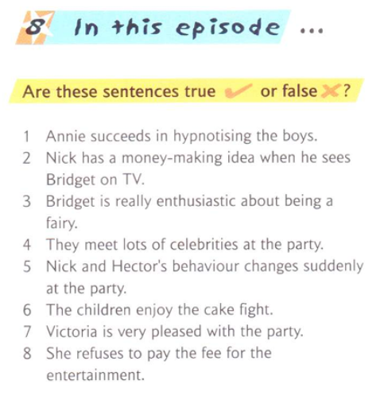
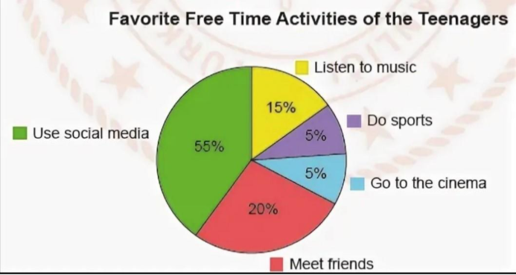
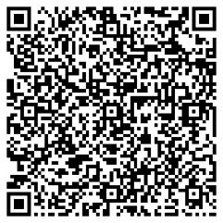
5. Write 7 sentences about this statistic and give your personal opinion.
6.Watch the episode and be ready to answer the questions in the next class:
QR на сериал:

Slide 23
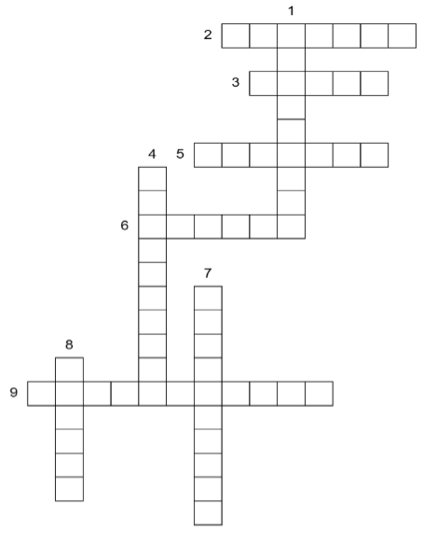
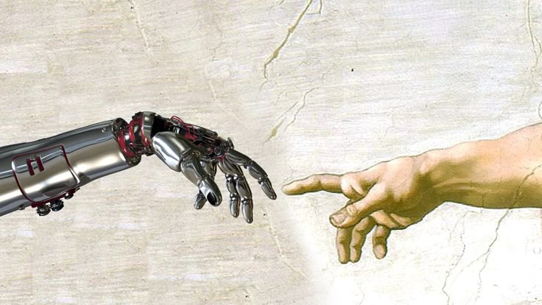
Module 8. Technology
1. Write the definitions for the following words.
Travel-worn –
Brass rail –
Hazy –
Anticipation –
Decade –
Expand –
Saddle –
2. Do the crossword.
1) a formal assurance (typically in writing) that certain conditions will be fulfilled, especially that a product will be repaired or replaced if not of a specified quality 2) relating to, using, or storing data or information in the form of digital signals 3) convenient to handle or use; useful 4) a small cassette recorder used to record speech for transcription at a later time | 5) a machine for printing text or pictures, especially one linked to a computer 6) demand (an amount) as a price for a service rendered or goods supplied 7) an optical instrument used for viewing very small objects, such as mineral samples or animal or plant cells 8) a portable computer that is small and light 9) a portable video camera.

Slide 24
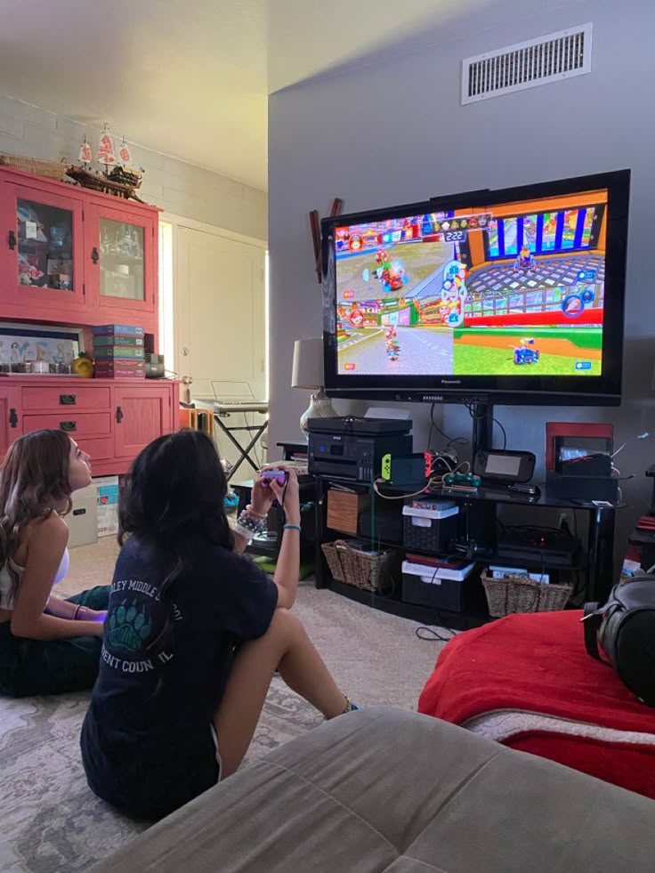
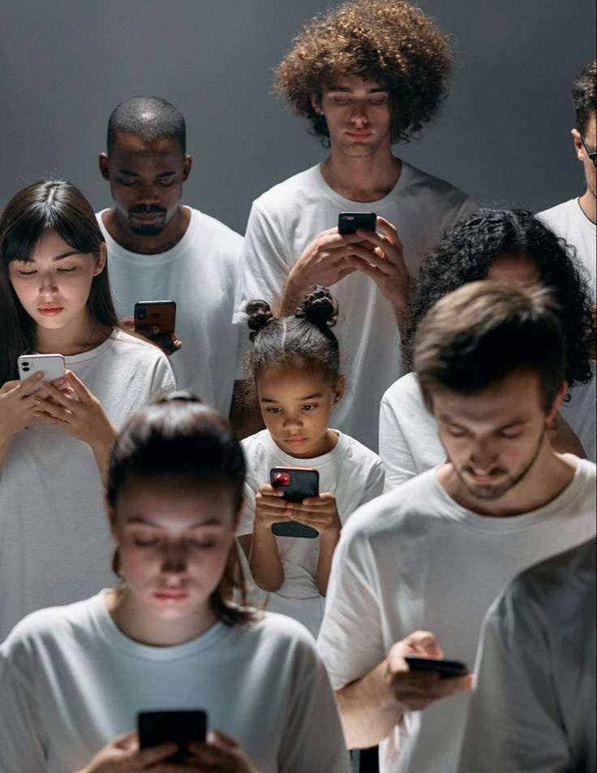
3. Fill in the gaps.
1. Tina often uses her __________ to record meetings and important notes.
2. My grandpa still has his old __________ and loves listening to cassettes.
3. She loves taking photos, so she always carries her __________.
4. Many business people rely on their __________ to manage their schedules and emails on the go.
5. I need to transfer some songs to my __________ before the long journey.
6. The new law is expected to __________ significant changes in the economy.
7. The smell of freshly baked bread always __________ happy memories of my childhood.
8. His constant worrying seems to __________ his headaches.
Words to insert:
Choose 1 picture to ask 4 questions about it, and describe the second picture in full using the following plan:
1.people 2. place 3. present continuous action 4. appearance | 5. clothes 6. feelings, emotions of people/ why do they feel it? 7.do you like/ dislike the picture and why
Camera bring about MP3 player bring back | voice recorder bring on Smartphone Walkman

Slide 25



6. Watch the episode and be ready to answer the questions in the next class:
QR на сериал:
5. Write 7 sentences about this statistic and give your personal opinion.

